Slide 1
Lecture 1
Cloud Computing
Instructor : Engr. Tehmeed

Slide 2
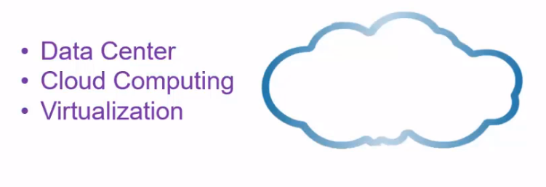

Slide 3
What is Cloud Computing?
On-demand availability of computer system resources, especially computing power and storage
automation of virtualization
Storing and accessing data and programs over the internet

Slide 4
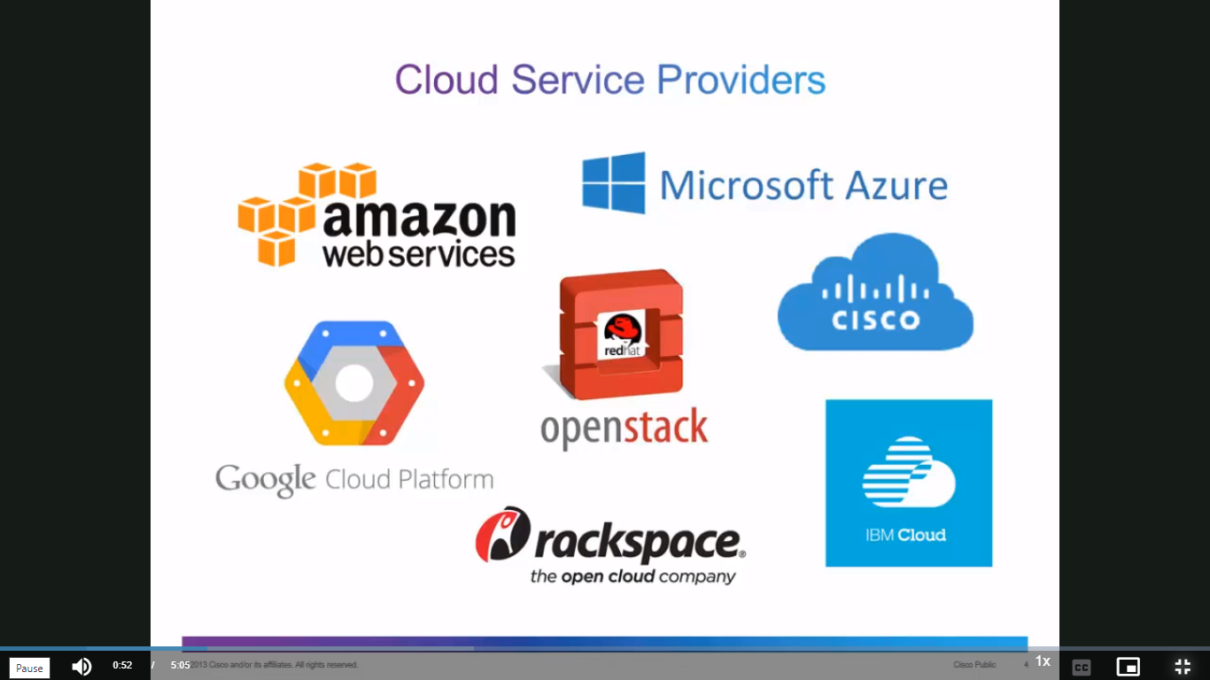

Slide 5
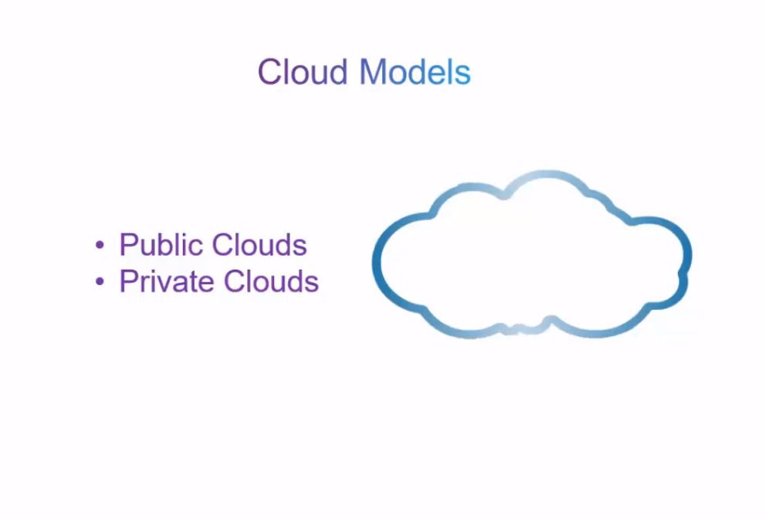

Slide 6
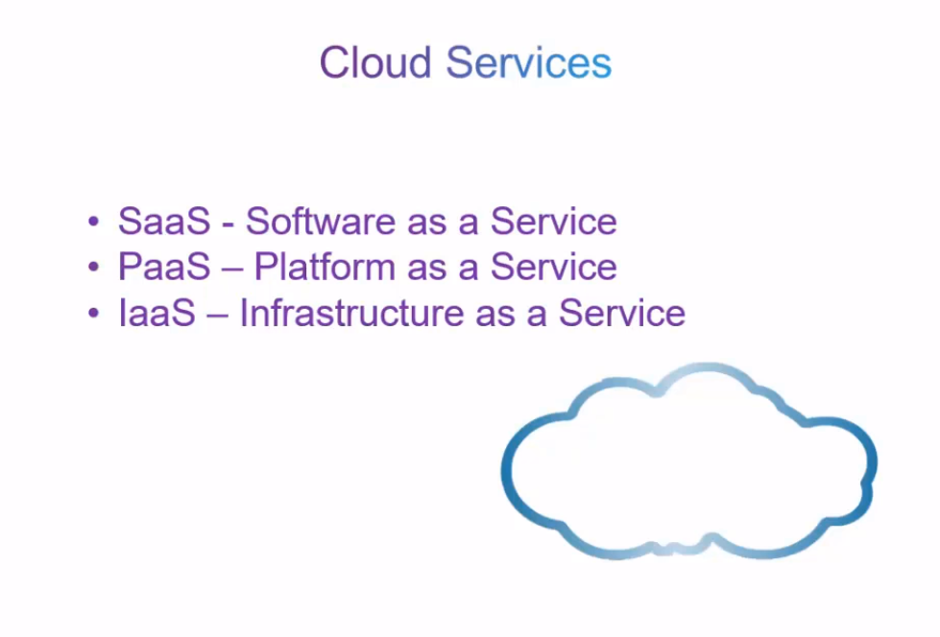

Slide 7
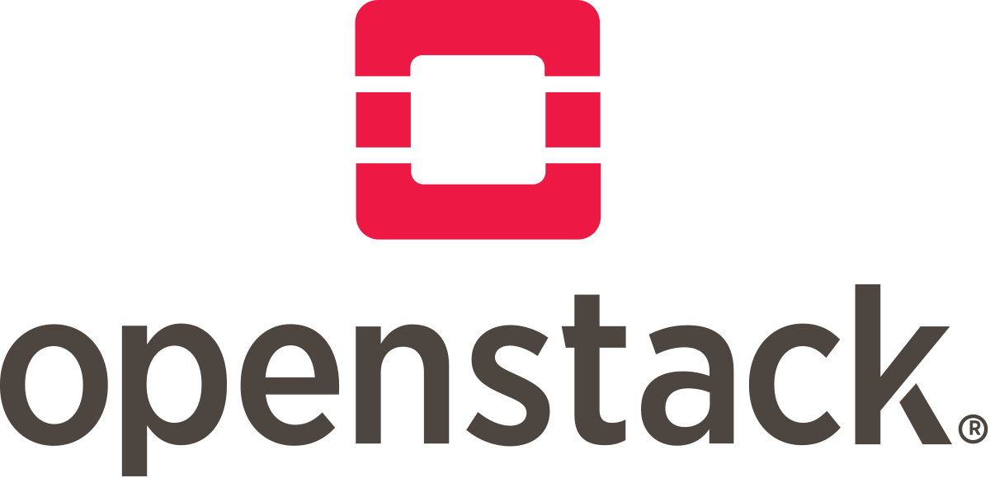
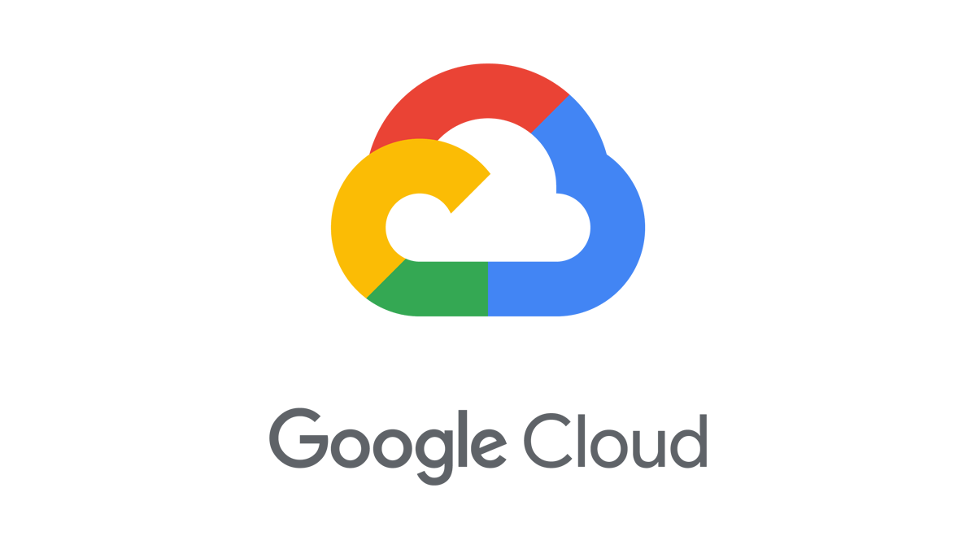




The Deployment Models of the Cloud
Private Cloud:
Cloud services used by a single organization, not exposed to the public.
Complete control
Security for sensitive applications
Meet specific business needs
Public Cloud:
Cloud resources owned and operated by a third- party cloud service provider delivered over the Internet.
Six Advantages of Cloud Computing
Hybrid Cloud:
Keep some servers on premises and extend some capabilities to the Cloud
Control over sensitive assets in your private infrastructure
Flexibility and cost- effectiveness of the public cloud

Slide 8
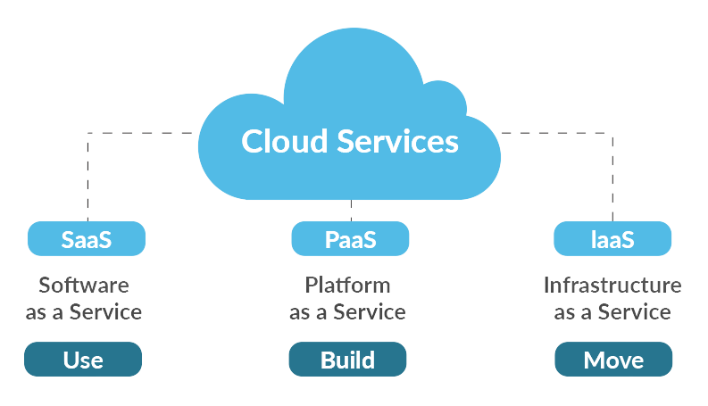
Service Models of Cloud Computing

Slide 9
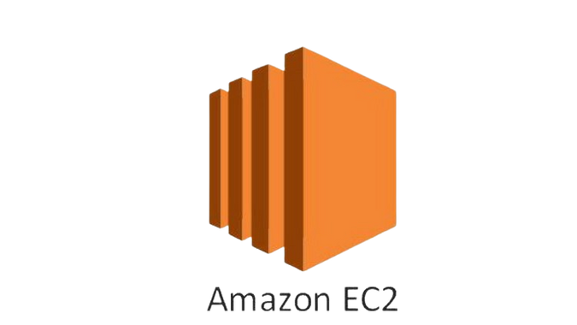
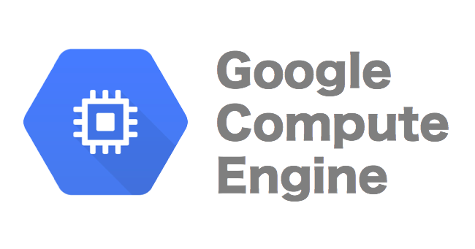
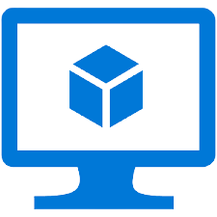


Infrastructure as a Service (IaaS)
Computing Resources over internet

Slide 10
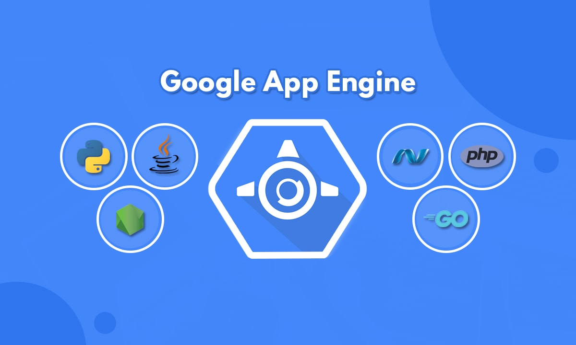

Platform as a Service (PaaS)
Tools over internet, usually for application development

Slide 11
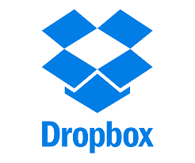
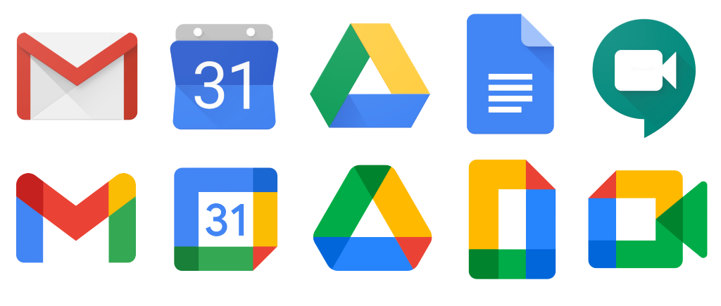

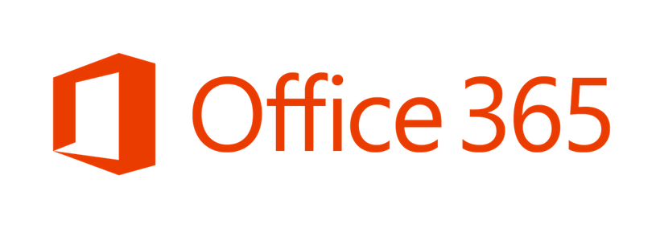
Software as a Service (SaaS)
Software Distribution Model

Slide 12

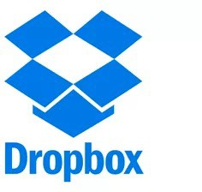

You’ve been using some Cloud services
Gmail
E-mail cloud service
Pay for ONLY your emails stored (no infrastructure, etc.)
Dropbox
Cloud Storage Service
Originally built on AWS
Netflix
Built on AWS
Video on Demand

Slide 13



Example of Cloud Computing Types
Infrastructure as a Service:
Amazon EC2 (on AWS)
GCP, Azure, Rackspace, Digital Ocean, Linode
Platform as a Service:
Elastic Beanstalk (on AWS)
Heroku, Google App Engine (GCP), Windows Azure (Microsoft)
Software as a Service:
Many AWS services (ex: Rekognition for Machine Learning)
Google Apps (Gmail), Dropbox, Zoom

Slide 14
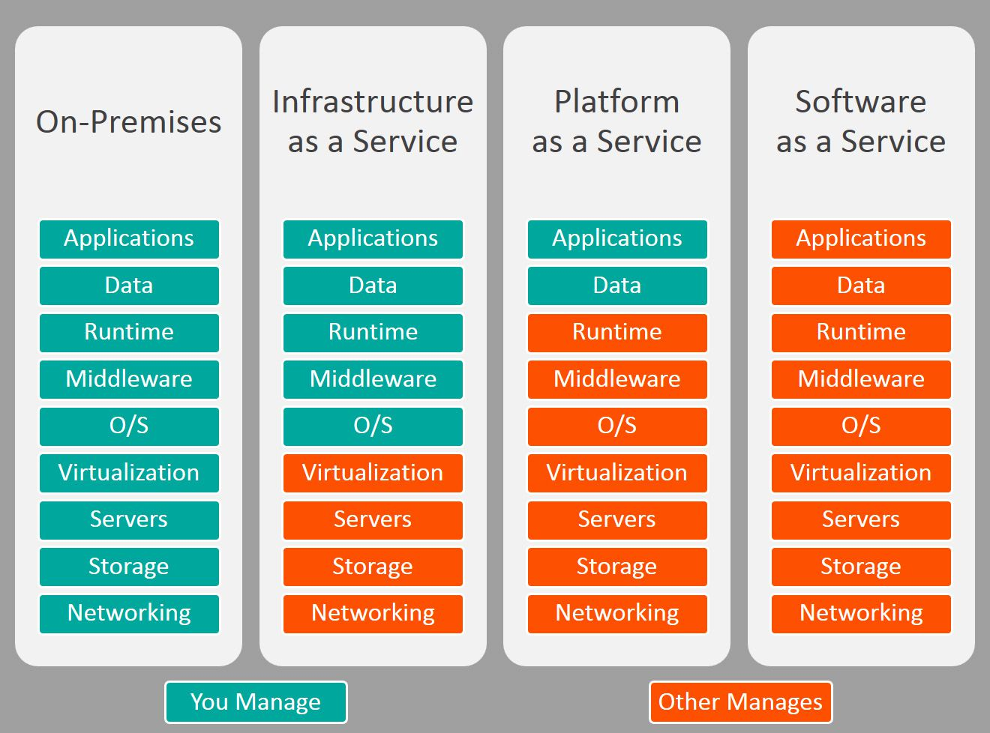

Slide 15

Any Questions ?

